Slide 1
UNIT3-S6 DISPLAY DETECTION DEVICESDEVICES,LIGHT SOURCES AND

Slide 2
LASER (Light Amplification by the Stimulated Emission of Radiation)
Laser is an optical oscillator. It comprises a resonant optical amplifier whose output is fed back into its input with matching phase. Any oscillator contains:
1- An amplifier with a gain-saturated mechanism
2- A feedback system
3- A frequency selection mechanism
4- An output coupling scheme
In laser the amplifier is the pumped active medium, such as biased semiconductor region, feedback can be obtained by placing active medium in an optical resonator, such as Fabry-Perot structure, two mirrors separated by a prescribed distance. Frequency selection is achieved by resonant amplifier and by the resonators, which admits certain modes. Output coupling is accomplished by making one of the resonator mirrors partially transmitting.

Slide 3
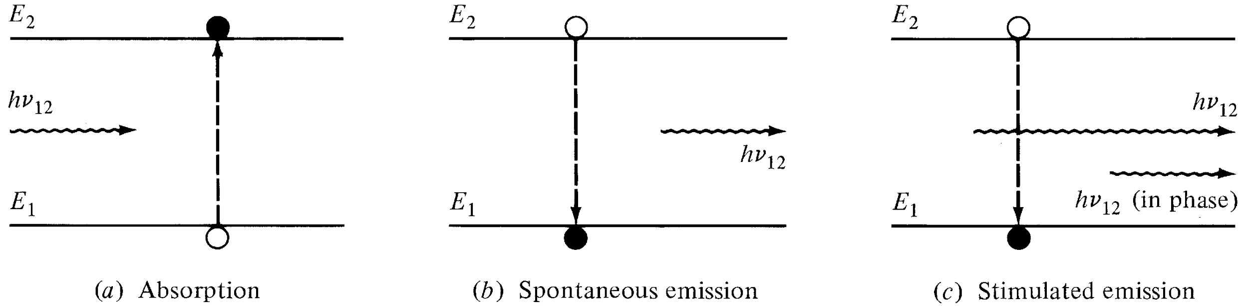
Pumped active medium
Three main process for laser action:
1- Photon absorption
2- Spontaneous emission
3- Stimulated emission
Optical Fiber communications, 3rd ed.,G.Keiser,McGrawHill, 2000

Slide 4
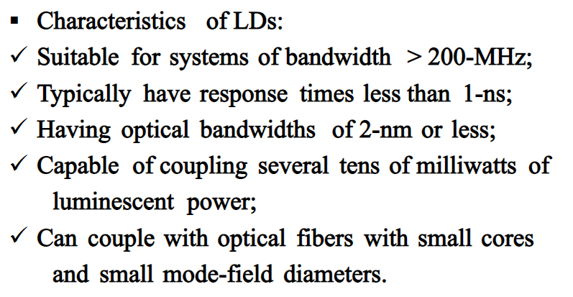
LASER DIODES

Slide 5
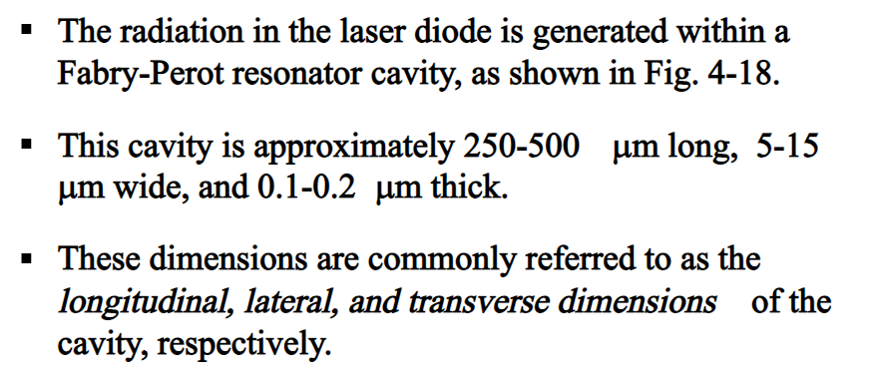
LASER DIODES

Slide 6
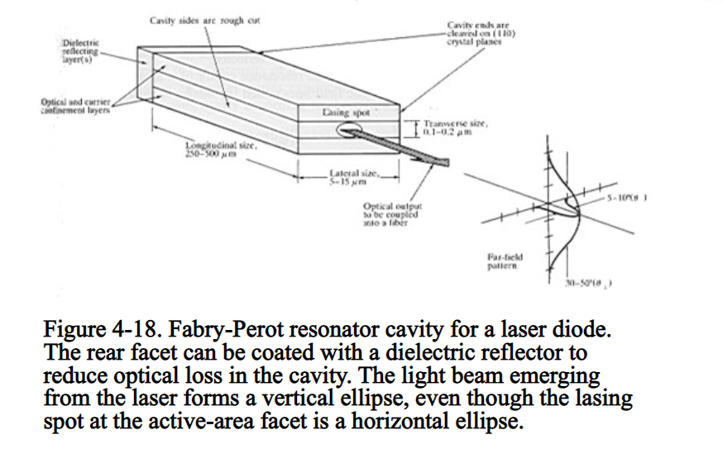

Slide 7
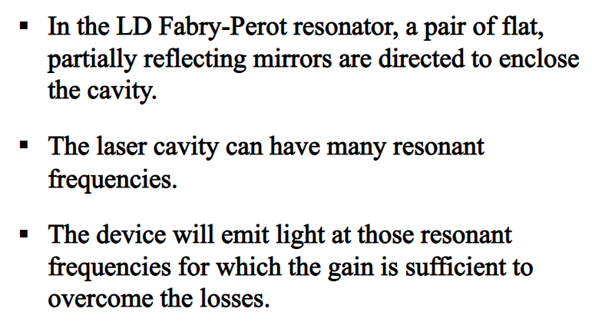

Slide 8
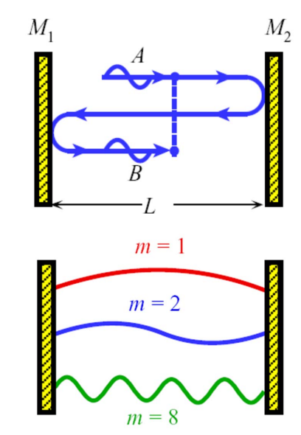
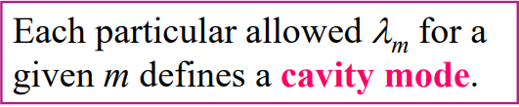
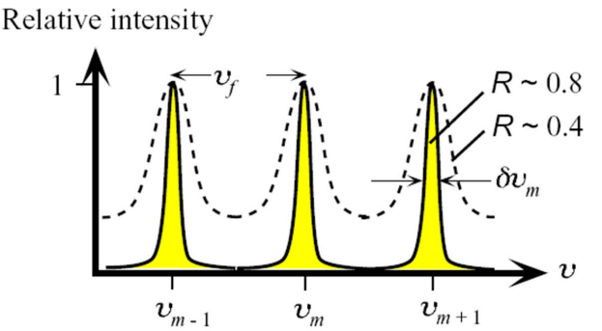

Slide 9
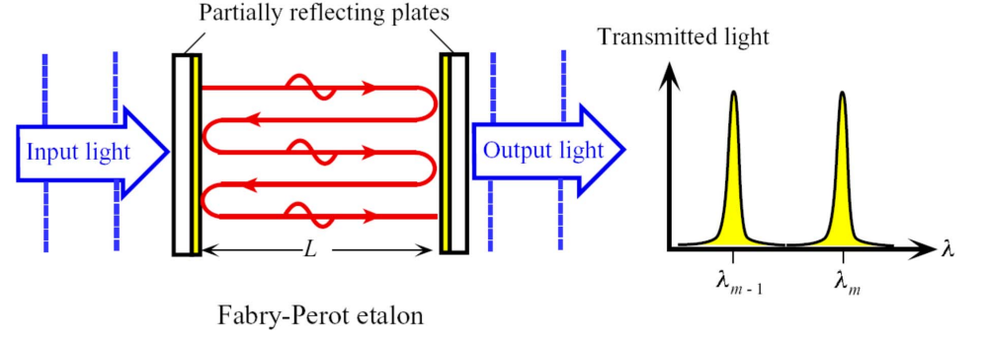

Slide 10
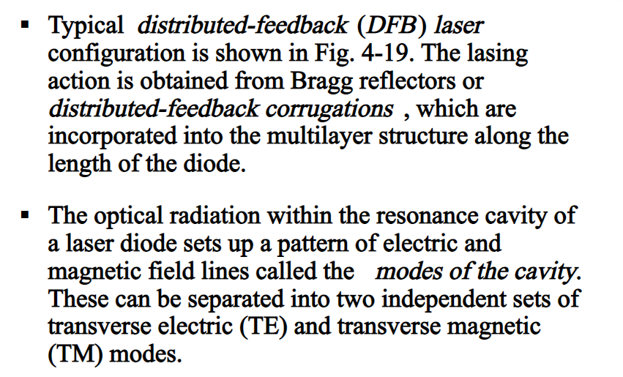

Slide 11
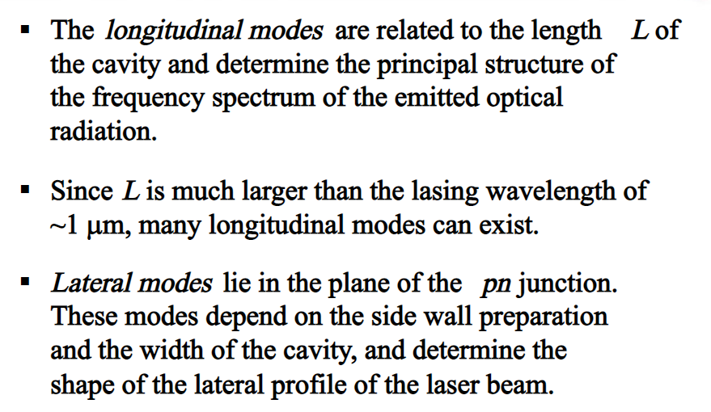

Slide 12
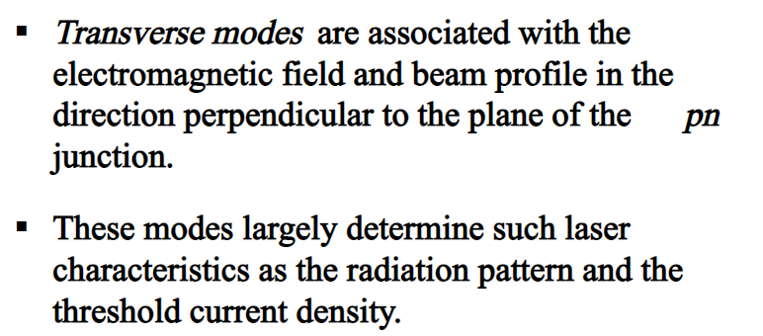
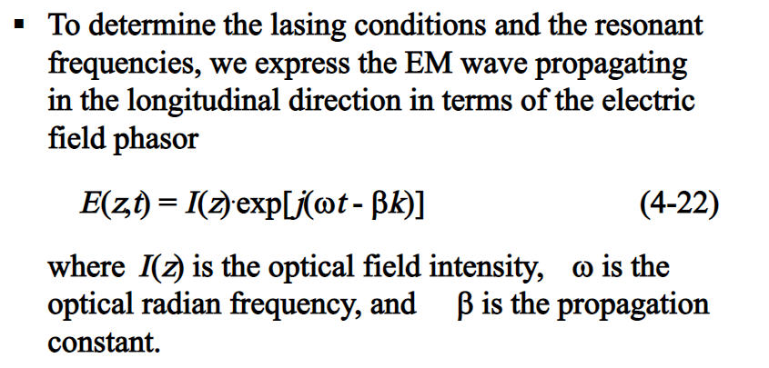

Slide 13
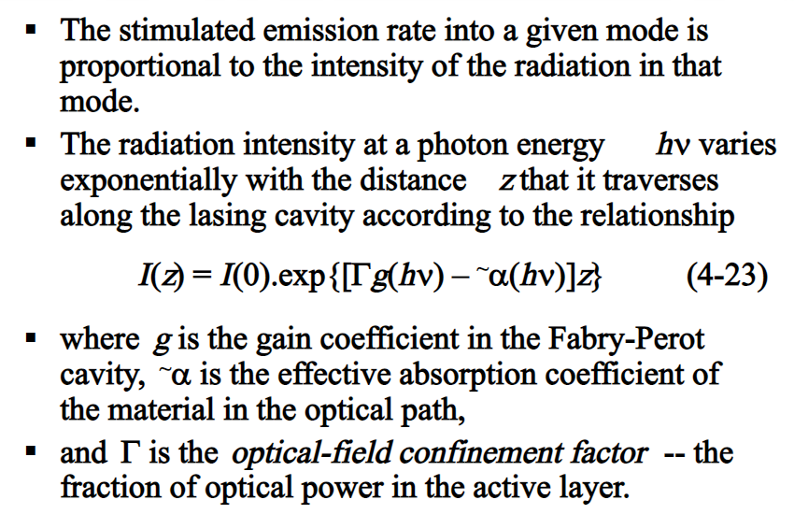

Slide 14
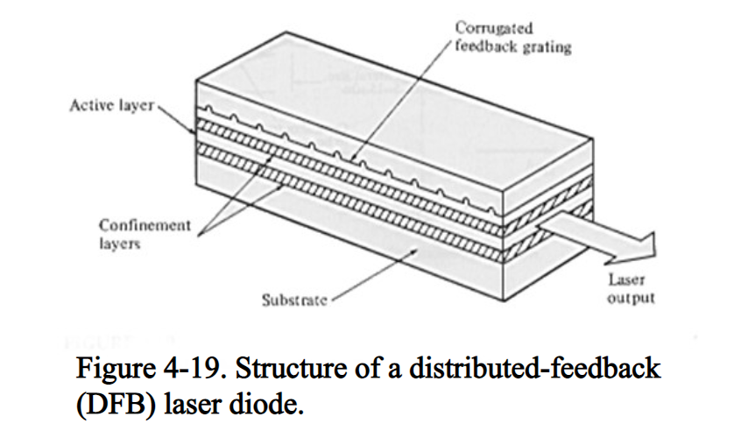

Slide 15
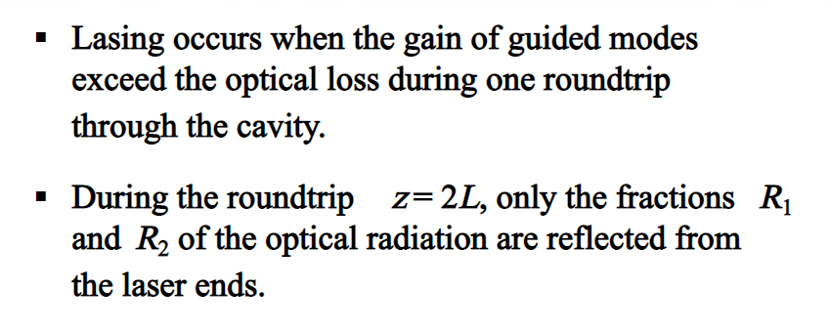
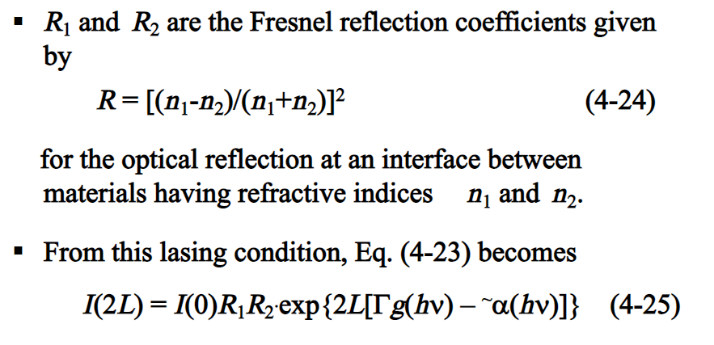

Slide 16
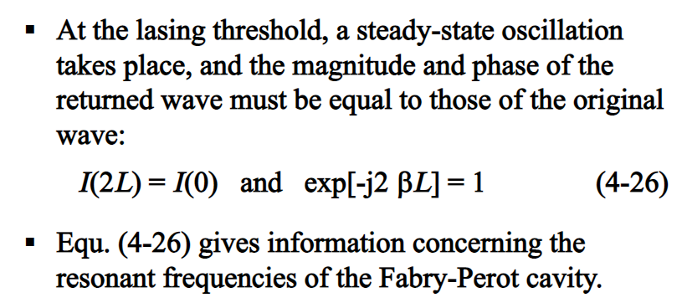

Slide 17
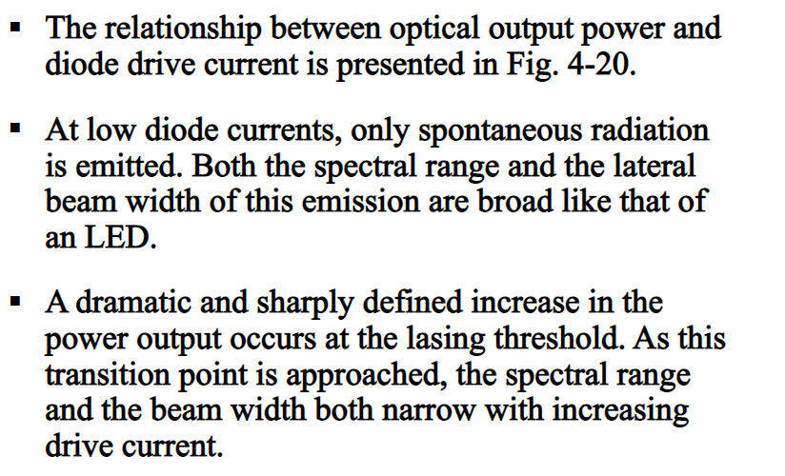

Slide 18
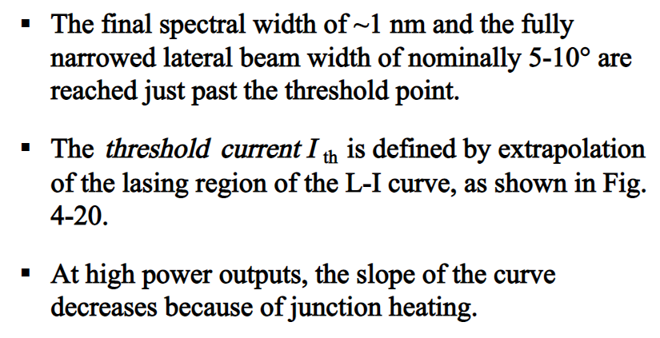

Slide 19
